Slide 1
The Western Mind
RUC, SPRING 2017

Slide 2
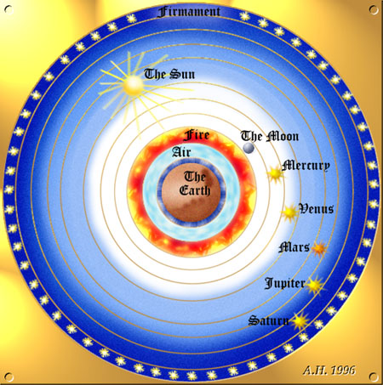
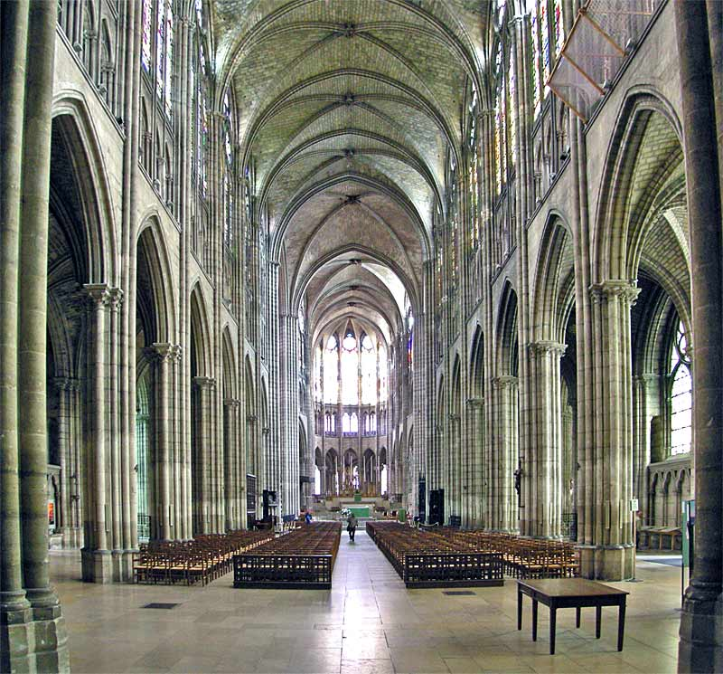
ANCIENT COSMOLOGY
THE ’POROUS’ SELF

Slide 3
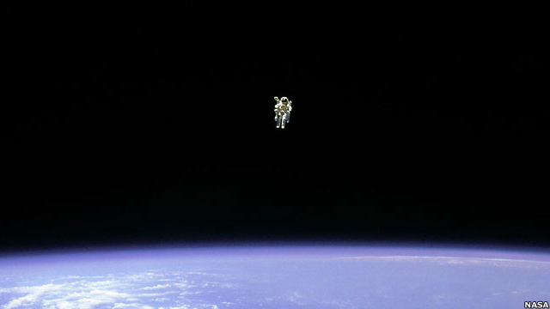
MODERN COSMOLOGY
THE ’BUFFERED’ SELF

Slide 4
What is a philosophical tradition?
There are geographical/cultural traditions of philosophy such as Chinese, Indian or Western philosophy.
The Western tradition includes classical, continental and analytical traditions, as well as Christian, Jewish and esoteric traditions of philosophy (cf. Taoist, Confucian, Buddhist in the Chinese tradition).
Arguably a tradition needs to a) have a beginning, b) later authors read earlier authors, c) some degree of common language (the Western tradition starts with classical philosophy and the common languages are first Greek and Latin (some Hebrew in the Middle Ages) with German, French and English dominant philosophical languages in the modern period.
Note the difference between philosophical and religious texts (the latter are primarily the Old (OT) and New Testament (NT). The OT was written in Hebrew and was translated into classical Greek before the Christian period (called the Septuagint). The NT was written in koine Greek (though the participants were largely Aramaic speaking). The Greek speaking authors of the NT knew the Septuagint. Both OT and NT were known largely in Latin until the modern period (Protestantism returned to the original Greek, and translated into modern European languages).
Philosophical and religious texts are different genres but for much of its existence the Western philosophical tradition has reflected the interaction of the two. Latin (often translations into Latin) was the common language in Western thought until the modern period. Modern Western philosophy still reflects something of this latinitas and there still remains a tension between Greek metaphysical thinking (classical and Christian) and Jewish ethical thinking (Hebrew).
We need to remember that despite the continuing authority of classical Greek philosophers such as Plato and Aristotle, the Greek language was generally not known in the West until the 16th century Renaissance (in Italy) and 19th century Romanticism (in Germany and Northern Europe). In the modern period Classical Greek culture has exercised a fascination over the Western mind.

Slide 5
AUGUSTINE: CONFESSIONS, Bk 10, Ch 10
17. But truly when I hear that there are three kinds of questions (whether a thing is?— what it is?— of what kind it is?), I do indeed hold fast the images of the sounds of which these words are composed, and I know that those sounds passed through the air with a noise, and now are not. But the things themselves which are signified by these sounds I never arrived at by any sense of the body, nor ever perceived them otherwise than by my mind; and in my memory have I stored not their images, but themselves, and let them tell me, if they are able, how it is that they entered into me. For I examine all the gates of my flesh, but cannot find where they entered. For the eyes say, if they were coloured, we announced them. The ears say, if they made a sound, we gave notice of them. The nostrils say, if they smell, they passed in by us. The sense of taste says, if they have no flavour, ask not me. The touch says, if it doesn’t have a body, I didn’t handle it, and if I never handled it, I didn’t indicate it. From where and how did these things enter into my memory? I don’t know. For when I learned them, I perceived them in my own heart and not in any one else’s heart. I approved them as true, and stored them there, in a place from which I could fetch them whenever I wished to. They existed then even before I learned them, but were not in my memory. Where were they, then, and why, when they were spoken, did I recognize them, and say, that’s how it is, these thoughts are true, unless they were already in my memory, though buried so deeply, as it were, in more secret caverns, that had they not been drawn forth by the advice of another I would not, perhaps, have been able to conceive of them?

Slide 6
ON THE TRINITY Bk 5, Ch 2, para.3
He is without doubt a substance, or essence, which the Greeks know as ousia, for as wisdom derives from being wise and knowledge from the act of knowing, so what we know as essence comes from being. And who can be said to exist more than he who said to his servant Moses ‘I am that I am’ and ‘thus shall you say to the children of Israel, He who is has sent me to you’. But other things which are called essences or substances admit of accidents, whereby they undergo a change, whether great or small. But there can be no accident of this kind with regard to God, and so he who is God is the only unchangeable substance or essence, to whom being itself, from which the name of essence derives, most truly belongs. For that which is changed does not retain its own being, and that which can undergo change, although it may not actually do so, can be that which it has not been. Therefore it is solely that which not only does not undergo change but also cannot do so which truly falls under the category of being.

Slide 7
Augustine on ‘being’
Augustine criticized, as improperly applied to God, the term “substance,” etymologically understood as standing under accidents. He advised that what the Greeks call ousia should be translated into Latin as essentia, i.e. being. As we have the word knowledge from “to know,” so we have being from “to be” (ab eo quod est esse dicta est essentia”).
“And who is more than he who said to his servant: ‘I am who am,’ and ‘Tell the sons of Israel: He who is sent me to you’?” (Exodus 3.14). That which cannot change deserves really and truly to “BE.” (Hebrew ehyeh asher ehyeh: ‘I am the one who did….’)
Augustine criticized the ambiguity resulting from the Latin translation of hypostasis by substantia. The Greeks called the Trinity one ousia and three hypostaseis. He commented: “I do not know what difference they wish to make between ousia and hypostasis.” When the Latins translate hypostasis by substantia, this Greek statement becomes one essentia or substantia and three substantiae (one being or substance and three substances!) Because of this resulting contradiction, the Latins called the Trinity one Substance (Being) and three Persons.
(Mary T. Clark, De Trinitate, Cambridge Companion to Augustine, pp. 95-6).

Slide 8
Thomas Aquinas: Summa theologia: First Part, Question 2, Article 3. Whether God exists?
Objection 1. It seems that God does not exist; because if one of two contraries be infinite, the other would be altogether destroyed. But the word "God" means that He is infinite goodness. If, therefore, God existed, there would be no evil discoverable; but there is evil in the world. Therefore God does not exist.
Objection 2. Further, it is superfluous to suppose that what can be accounted for by a few principles has been produced by many. But it seems that everything we see in the world can be accounted for by other principles, supposing God did not exist. For all natural things can be reduced to one principle which is nature; and all voluntary things can be reduced to one principle which is human reason, or will. Therefore there is no need to suppose God's existence.
On the contrary, It is said in the person of God: "I am Who am." (Exodus 3:14)
I answer that, The existence of God can be proved in five ways.

Slide 9
Thomas Aquinas: Summa theologia: First Part, Question 2, Article 3. Whether God exists?
The first and more manifest way is the argument from motion. It is certain, and evident to our senses, that in the world some things are in motion. Now whatever is in motion is put in motion by another, for nothing can be in motion except it is in potentiality to that towards which it is in motion; whereas a thing moves inasmuch as it is in act. For motion is nothing else than the reduction of something from potentiality to actuality. But nothing can be reduced from potentiality to actuality, except by something in a state of actuality. Thus that which is actually hot, as fire, makes wood, which is potentially hot, to be actually hot, and thereby moves and changes it. Now it is not possible that the same thing should be at once in actuality and potentiality in the same respect, but only in different respects. For what is actually hot cannot simultaneously be potentially hot; but it is simultaneously potentially cold. It is therefore impossible that in the same respect and in the same way a thing should be both mover and moved, i.e. that it should move itself. Therefore, whatever is in motion must be put in motion by another. If that by which it is put in motion be itself put in motion, then this also must needs be put in motion by another, and that by another again. But this cannot go on to infinity, because then there would be no first mover, and, consequently, no other mover; seeing that subsequent movers move only inasmuch as they are put in motion by the first mover; as the staff moves only because it is put in motion by the hand. Therefore it is necessary to arrive at a first mover, put in motion by no other; and this everyone understands to be God.

Slide 10
Thomas Aquinas: Summa theologia: First Part, Question 2, Article 3. Whether God exists?
The second way is from the nature of the efficient cause. In the world of sense we find there is an order of efficient causes. There is no case known (neither is it, indeed, possible) in which a thing is found to be the efficient cause of itself; for so it would be prior to itself, which is impossible. Now in efficient causes it is not possible to go on to infinity, because in all efficient causes following in order, the first is the cause of the intermediate cause, and the intermediate is the cause of the ultimate cause, whether the intermediate cause be several, or only one. Now to take away the cause is to take away the effect. Therefore, if there be no first cause among efficient causes, there will be no ultimate, nor any intermediate cause. But if in efficient causes it is possible to go on to infinity, there will be no first efficient cause, neither will there be an ultimate effect, nor any intermediate efficient causes; all of which is plainly false. Therefore it is necessary to admit a first efficient cause, to which everyone gives the name of God.

Slide 11
Thomas Aquinas: Summa theologia: First Part, Question 2, Article 3. Whether God exists?
The third way is taken from possibility and necessity, and runs thus. We find in nature things that are possible to be and not to be, since they are found to be generated, and to corrupt, and consequently, they are possible to be and not to be. But it is impossible for these always to exist, for that which is possible not to be at some time is not. Therefore, if everything is possible not to be, then at one time there could have been nothing in existence. Now if this were true, even now there would be nothing in existence, because that which does not exist only begins to exist by something already existing. Therefore, if at one time nothing was in existence, it would have been impossible for anything to have begun to exist; and thus even now nothing would be in existence — which is absurd. Therefore, not all beings are merely possible, but there must exist something the existence of which is necessary. But every necessary thing either has its necessity caused by another, or not. Now it is impossible to go on to infinity in necessary things which have their necessity caused by another, as has been already proved in regard to efficient causes. Therefore we cannot but postulate the existence of some being having of itself its own necessity, and not receiving it from another, but rather causing in others their necessity. This all men speak of as God.

Slide 12
Thomas Aquinas: Summa theologia: First Part, Question 2, Article 3. Whether God exists?
The fourth way is taken from the gradation to be found in things. Among beings there are some more and some less good, true, noble and the like. But "more" and "less" are predicated of different things, according as they resemble in their different ways something which is the maximum, as a thing is said to be hotter according as it more nearly resembles that which is hottest; so that there is something which is truest, something best, something noblest and, consequently, something which is uttermost being; for those things that are greatest in truth are greatest in being, as it is written in Metaph. ii. Now the maximum in any genus is the cause of all in that genus; as fire, which is the maximum heat, is the cause of all hot things. Therefore there must also be something which is to all beings the cause of their being, goodness, and every other perfection; and this we call God.

Slide 13
Thomas Aquinas: Summa theologia: First Part, Question 2, Article 3. Whether God exists?
The fifth way is taken from the governance of the world. We see that things which lack intelligence, such as natural bodies, act for an end, and this is evident from their acting always, or nearly always, in the same way, so as to obtain the best result. Hence it is plain that not fortuitously, but designedly, do they achieve their end. Now whatever lacks intelligence cannot move towards an end, unless it be directed by some being endowed with knowledge and intelligence; as the arrow is shot to its mark by the archer. Therefore some intelligent being exists by whom all natural things are directed to their end; and this being we call God.

Slide 14
Thomas Aquinas: the Act of Existence
‘Everything which comes after the first being, since it is not its esse, has an esse which is received in something by which the esse is limited; and thus in every creature the nature of the thing which participates esse is one, and the participated esse is something else. And since everything participates in the first act by assimilation in so far as it has esse, the participated esse in each thing must be related to the nature which participates in it as act to potency.’
(Aquinas on Spiritual Creatures)
According to the last sentence, everything participates in the First Act by assimilation to the extent to which it itself enjoys esse. But the remainder of that sentence refers to a nature that participates in the esse (or act of being) which is intrinsic to the creature.
This suggests that Aquinas speaks of created or caused entities or natures as participating in esse in three ways: 1) as participating in esse commune (being in general), 2) as participating in subsisting esse (God) and 3) as participating in the esse (act of being) that is intrinsically realized in the existing creature (ens)
N. Kretzmann, Cambridge Companion to Aquinas, 98.

Slide 15
Thomas Aquinas: the Act of Existence
‘Note the difference between esse and ens
What something is
And that something is
‘the dog exists’. This difference is the principle of createdness
But in Thomas’ Deus, esse and ens are the same:
Deus exists as the principle of existence: as Creator
The beginning of a distinctively Western metaphysics?

